Slide 1
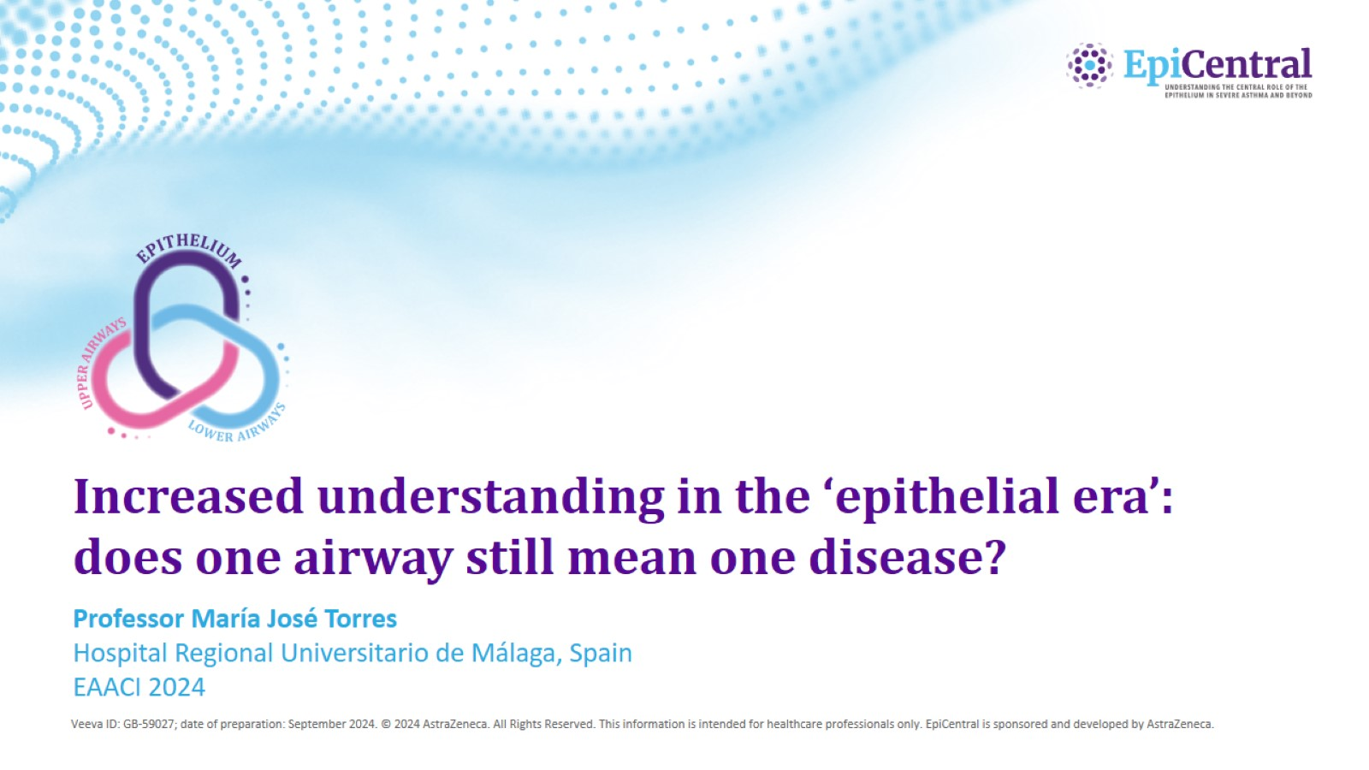
Increased understanding in the ‘epithelial era’: does one airway still mean one disease?

Slide 2
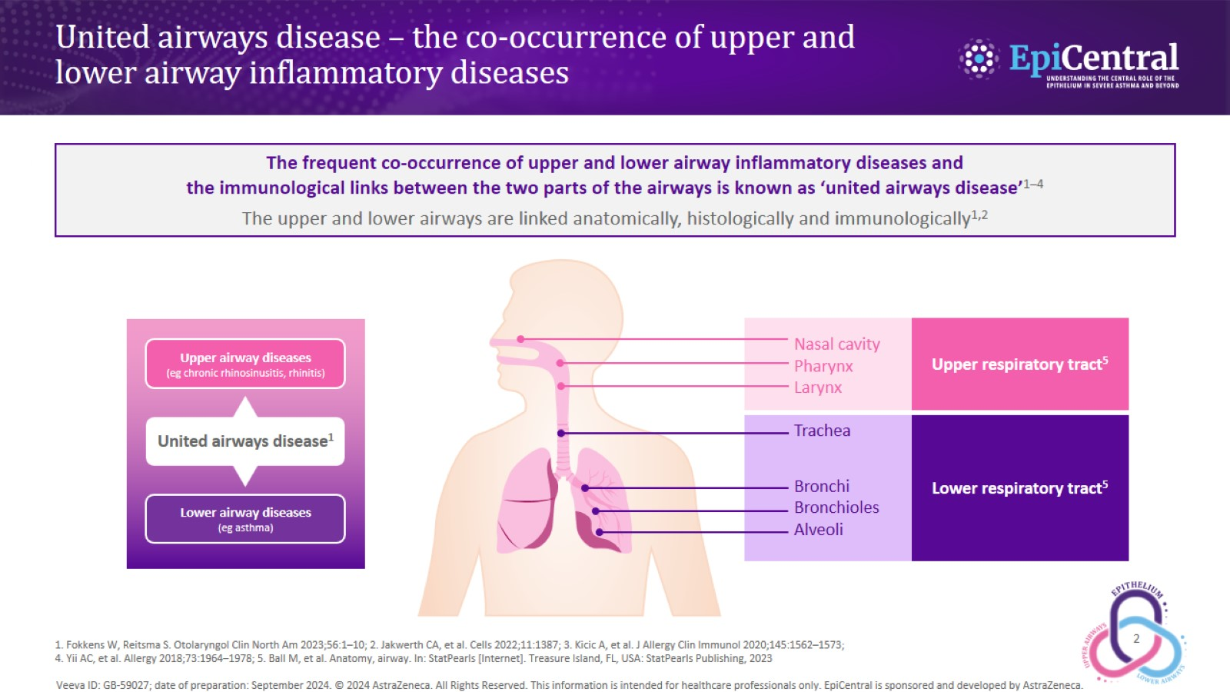
United airways disease – the co-occurrence of upper and lower airway inflammatory diseases

Slide 3
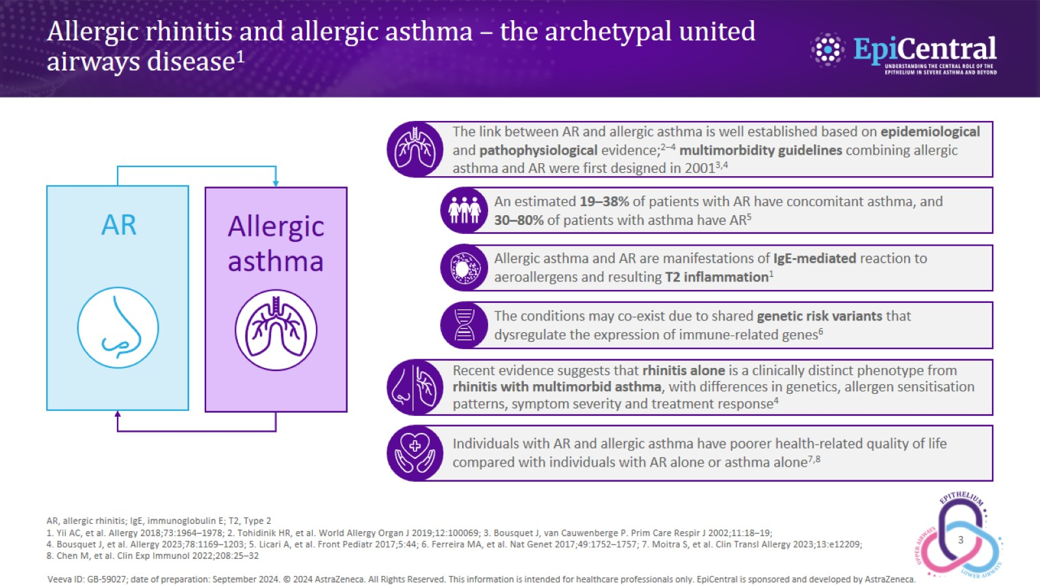
Allergic rhinitis and allergic asthma – the archetypal united airways disease¹

Slide 4
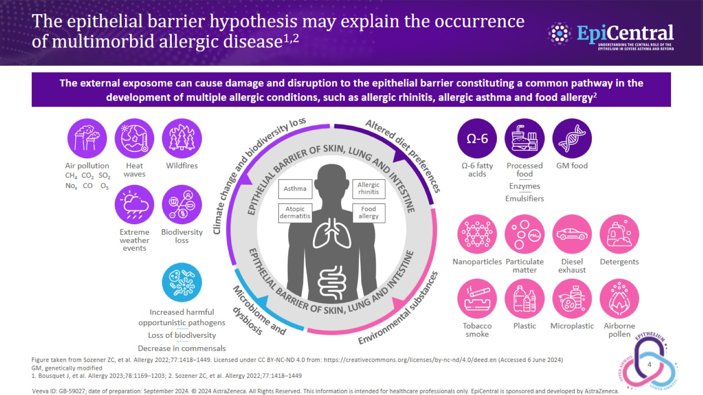
The epithelial barrier hypothesis may explain the occurrence of multimorbid allergic disease^{1,2}

Slide 5
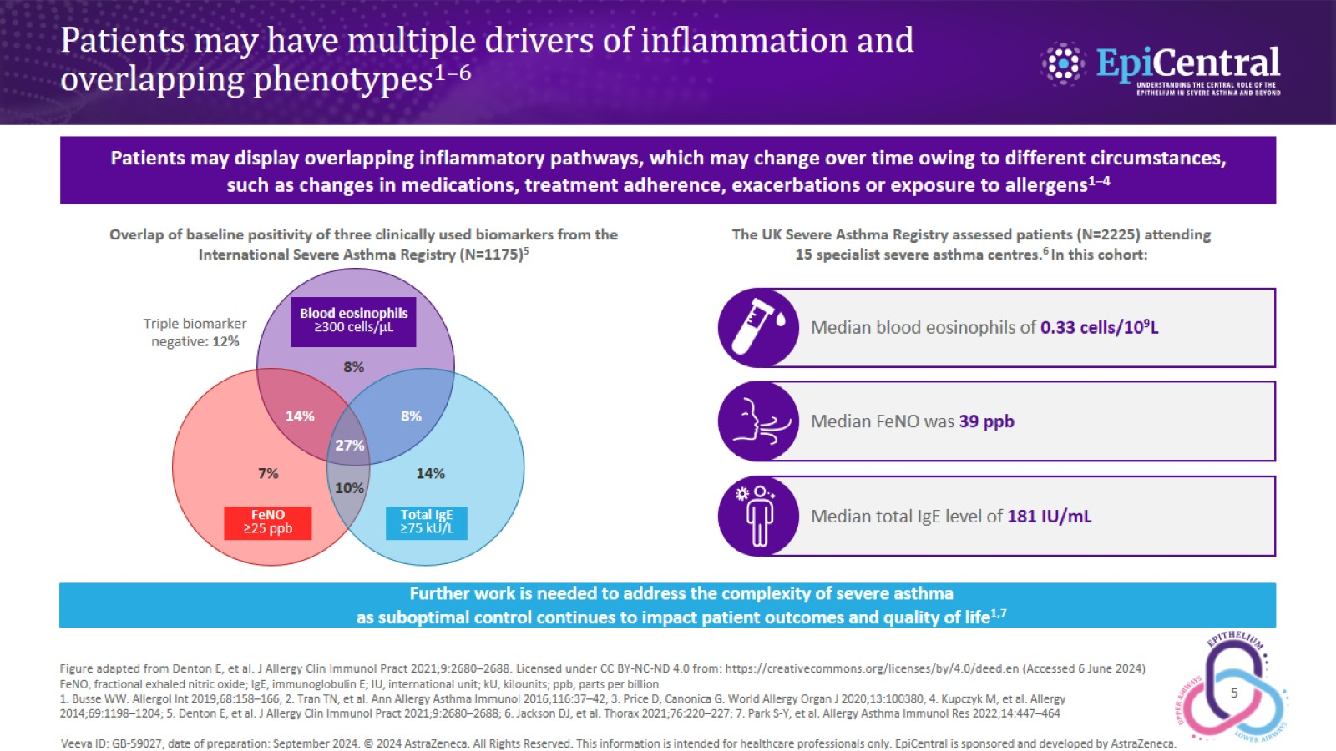
Patients may have multiple drivers of inflammation and overlapping phenotypes^{1–6}

Slide 6
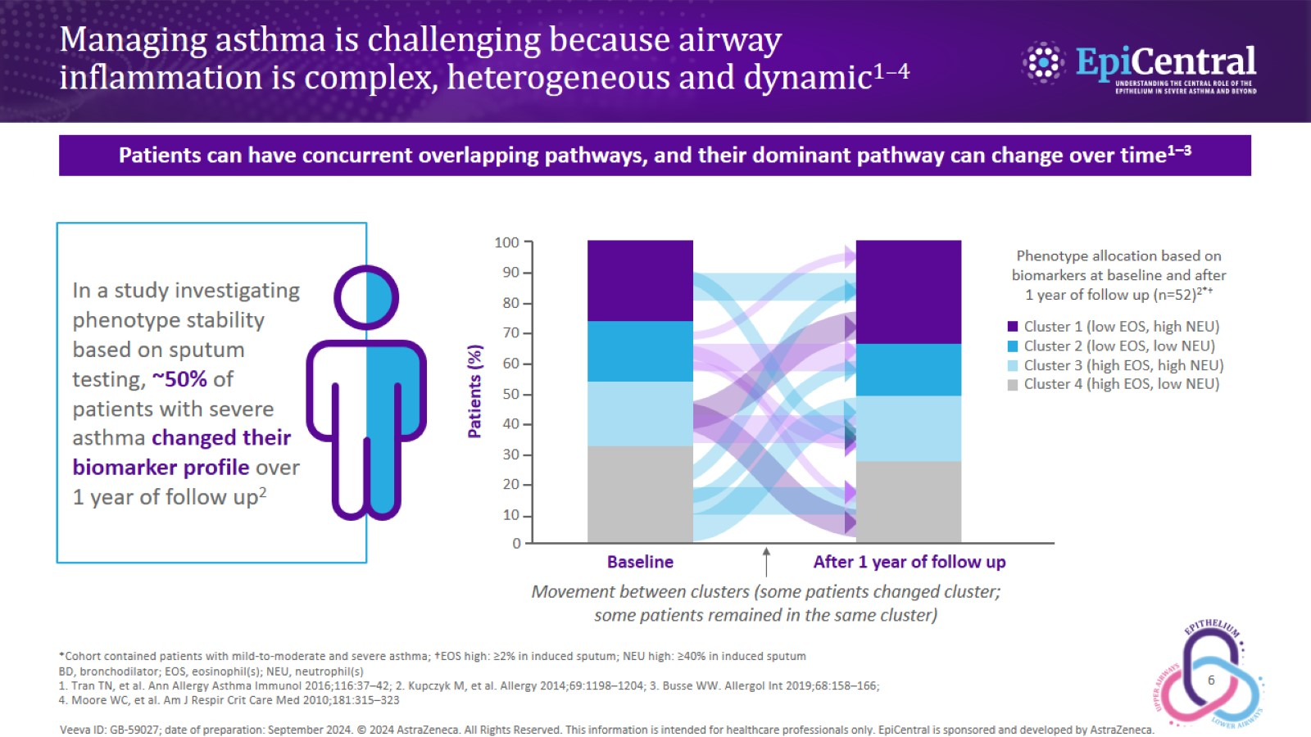
Managing asthma is challenging because airway inflammation is complex, heterogeneous and dynamic^{1–4}

Slide 7
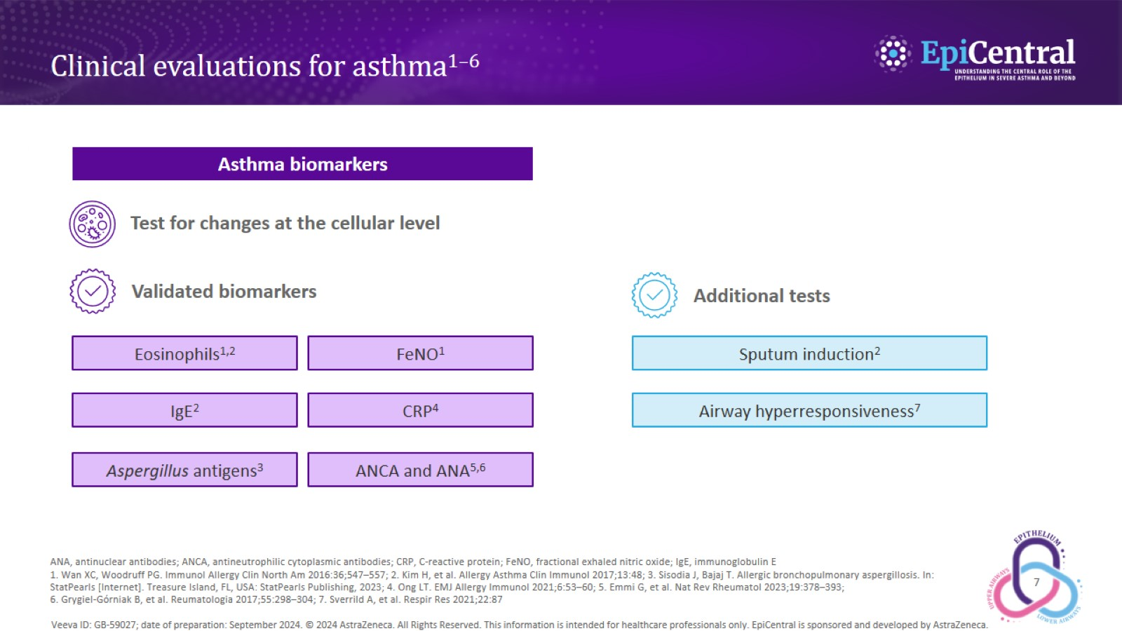
Clinical evaluations for asthma^{1–6}

Slide 8
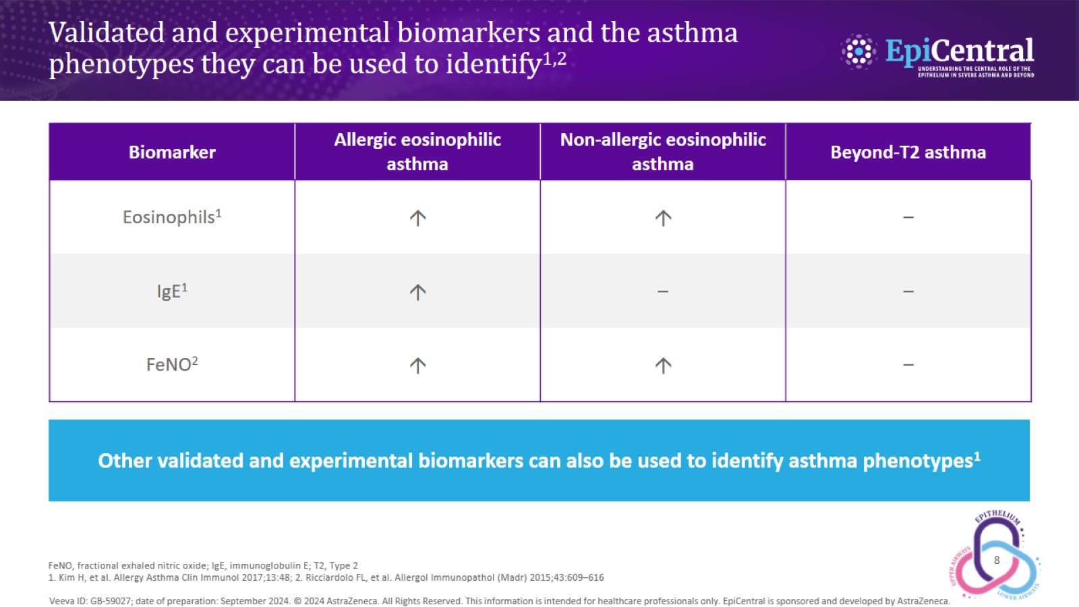
Validated and experimental biomarkers and the asthma phenotypes they can be used to identify^{1,2}

Slide 9
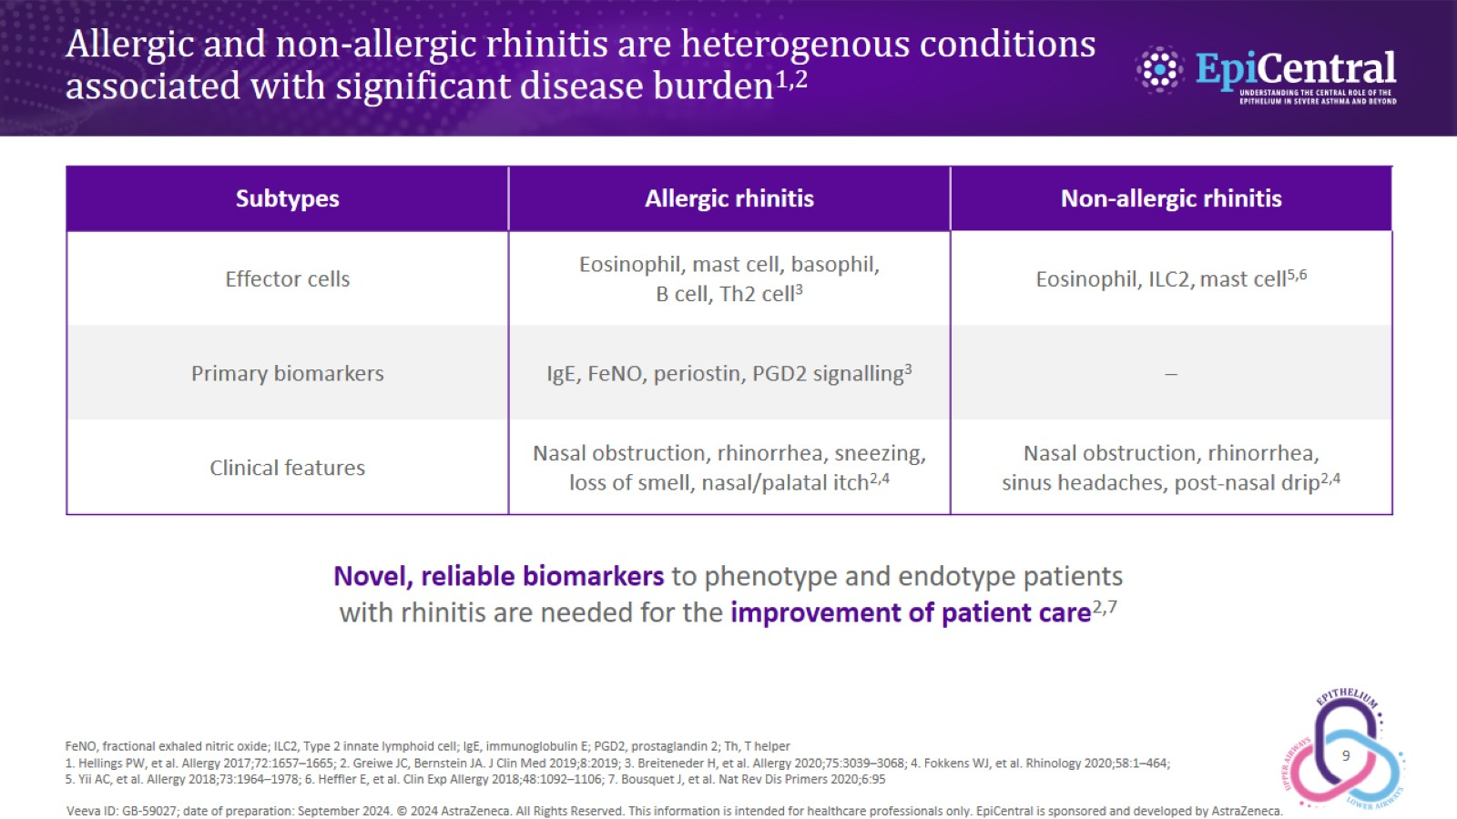
Allergic and non-allergic rhinitis are heterogenous conditions associated with significant disease burden^{1,2}

Slide 10
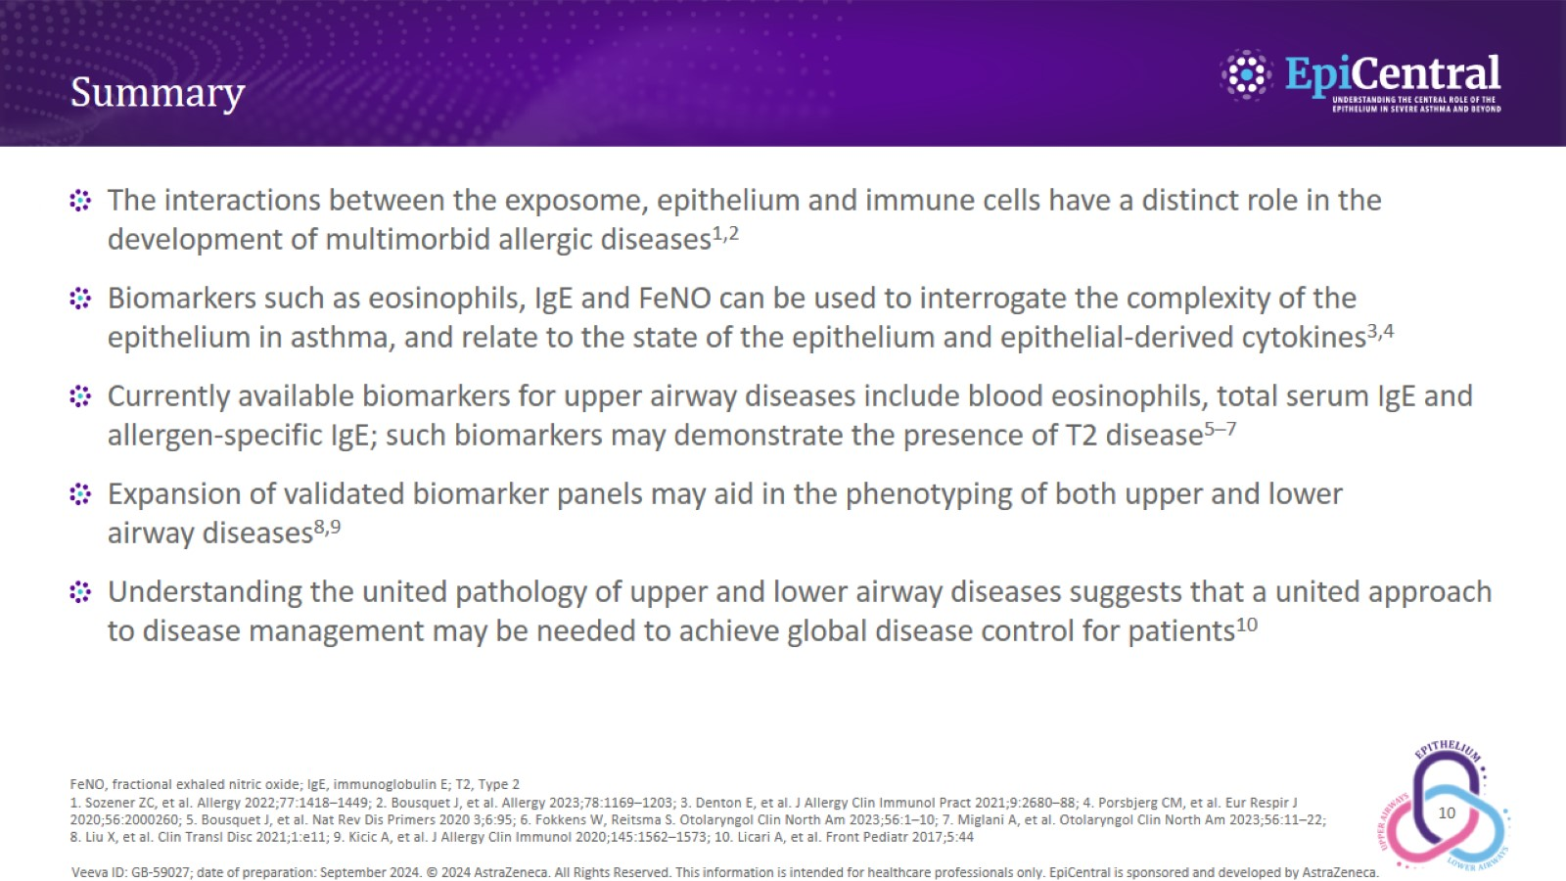
Summary

